Slide 1


Flight Price Detection Group 9- Predicting Optimal Airfares through Advanced Regression
Guna Sekhar Chowdary Kollu,
Yogesh Muppiri,
Srija Mannam,
Sai Madhan Muthyam,
Veda Swaroop Dasagrandhi,
Bhanu Kiran Reddy Eedala

Slide 2
Agenda :
Data
Data Preparation
Feature Engineering
Exploratory Data Analysis
Model Deployment
Conclusion

Slide 3
Data :
Research Question:
How can we predict the optimal airfares for specific destinations, routes, and schedules for domestic flights in India?
Problem Statement:
Airfare pricing is a dynamic and complex process influenced by numerous factors including time of day, route, flight duration, and the number of stops. For travelers, understanding when to purchase tickets at the best price is challenging due to frequent price fluctuations.

Slide 4
Objective:
The aim of this project is to develop a predictive model that can forecast flight prices accurately. This model seeks to assist travelers in identifying the most affordable times to purchase flight tickets, specifically pinpointing days when fares are least expensive.
Justification:
By leveraging regression analysis techniques, this project endeavors to reveal the underlying relationships between flight ticket prices and the various determinants of air travel. With about 10,000 domestic flight records from a Kaggle dataset, the model intends to provide insights into fare trends and help travelers make cost-effective decisions.

Slide 5
Significance:
This project addresses the practical issue of airfare affordability in the airline industry. By creating a tool for forecasting airfares, it could potentially benefit both consumers seeking budget-friendly travel options and airlines optimizing their pricing strategies.

Slide 6

Data Preparation:
Loading the dataset
Checking null values & random characters
Getting summary of the dataset
Data Cleaning
Analyzing the features
Interpreting relationship between dependent and independent variables
Checking for outliers and removing them using Z score method
Checking for skewness and normalizing data distribution using PowerTransformer

Slide 7
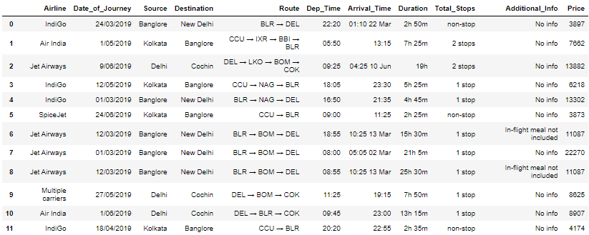
Initial Data :

Slide 8
Feature Engineering :
Dropping Route(redundant as no of stops is included) and additional info(approx 80% data no info)
Convert the date column to datetime format and then to mmddyyyy format
Change the format of Date_of_Journey, Dep_Time, Arrival_Time, Dutation,Total_Stops
Changing month to object from numeric
Converting the values in Duration column to minutes
Converting Arrival_Time into date and time separately
Changing Total_Stops to max 2+ stops
Checking for Outliers in continuous data type Features
Removing Outliers using Z score Method since it has a low data loss %
Checking for skewness in data distributions

Slide 9
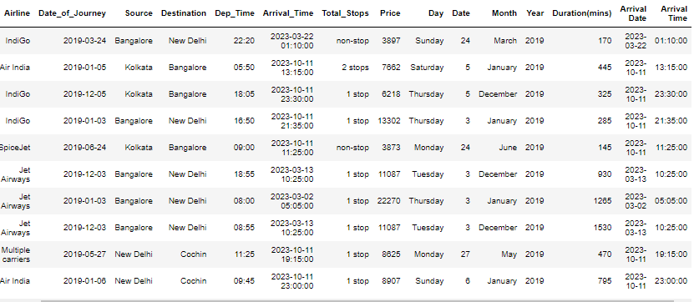

Slide 10
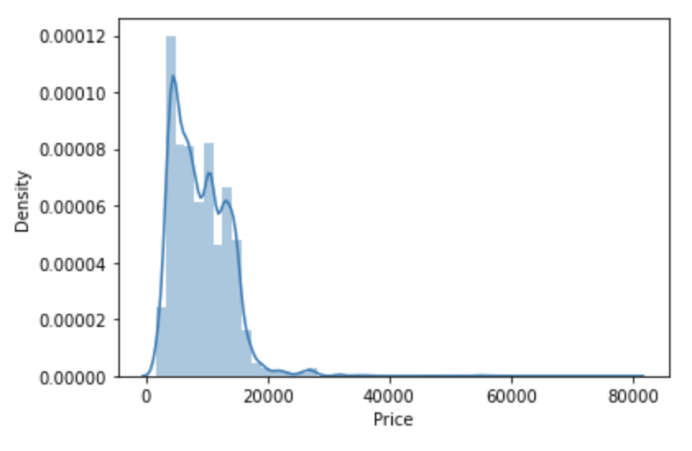
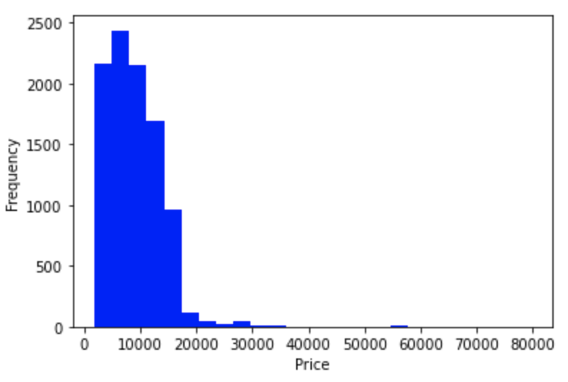
Exploratory Data Analysis
Price data forms a continuous distribution with mean of 8998.73 and is skewed to the right which indicates that majority of the data points are concentrated on the left side of the graph, and there are some outliers on the right side
This indicates that there are some flights with very high prices that are affecting the overall distribution of prices, making it skewed to the right

Slide 11
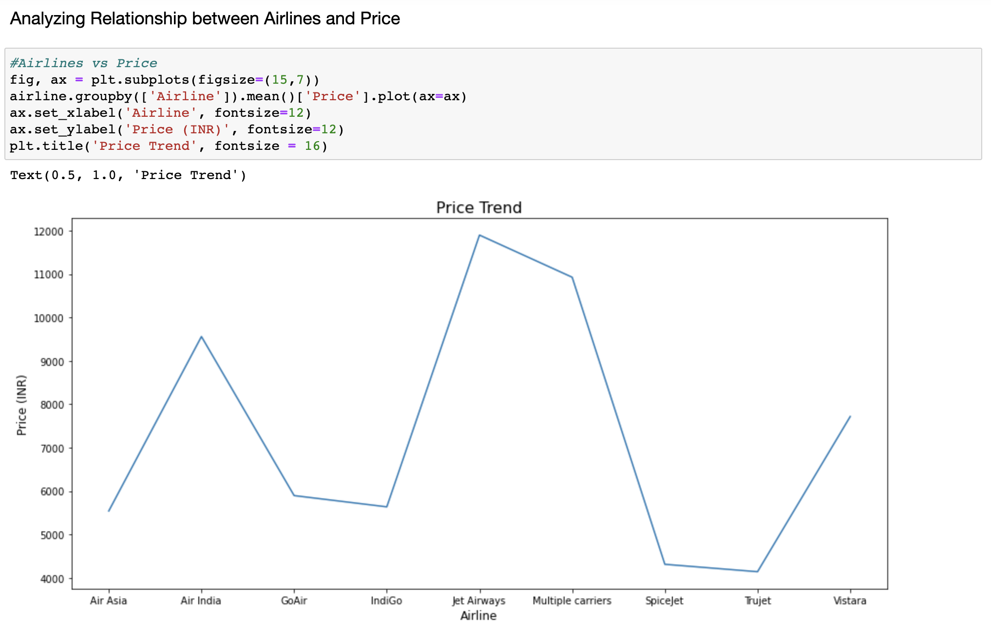
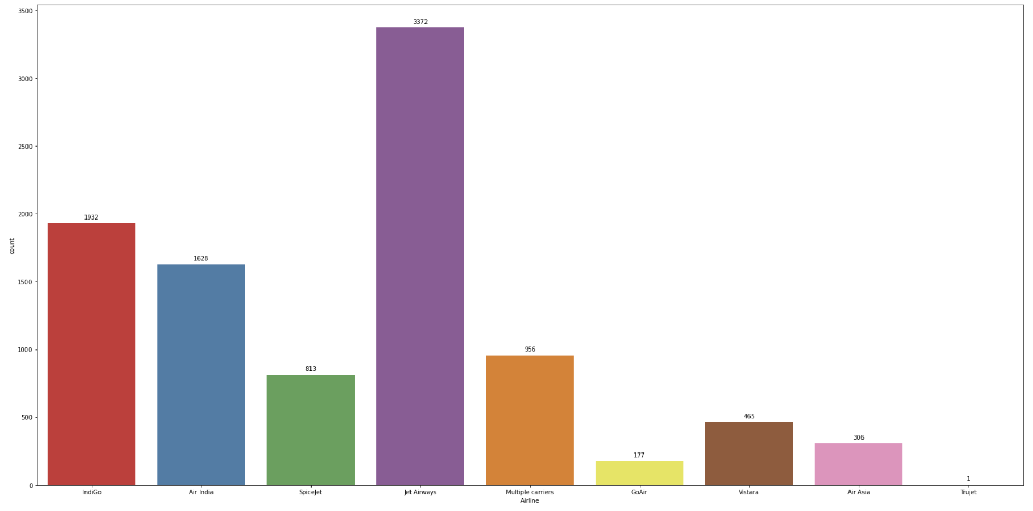
Truejet, SpiceJet, IndiGo and Air Asia offer air tickets at the most affordable prices on average
Jet Airways, Multiple carriers, Air India and Vistara are the most expensive on average
Jet Airways has the highest number of flights followed by IndiGo and Air India

Slide 12
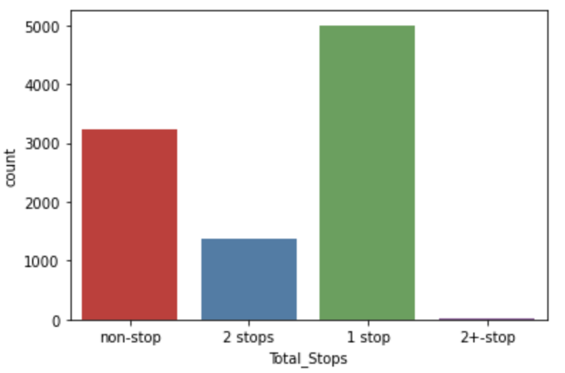
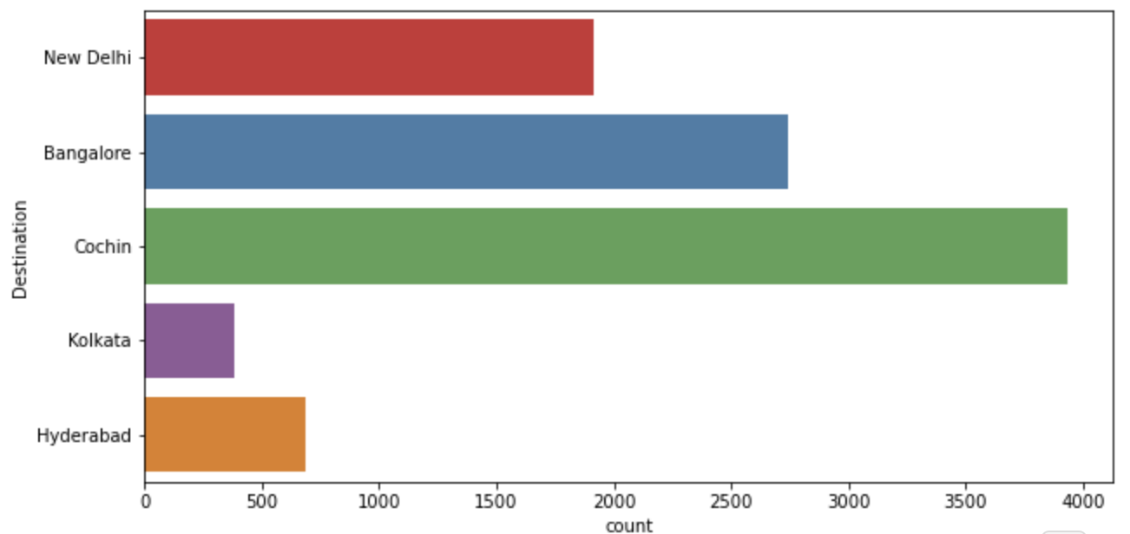
Cochin is the most popular destination followed by Bangalore, New Delhi, Hyderabad and Kolkata
Highest number of flights have only 1 stop between source and destination while second highest number of flights are non-stop

Slide 13
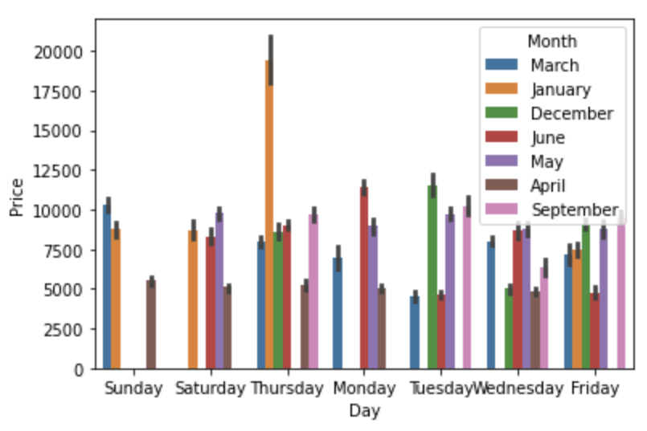
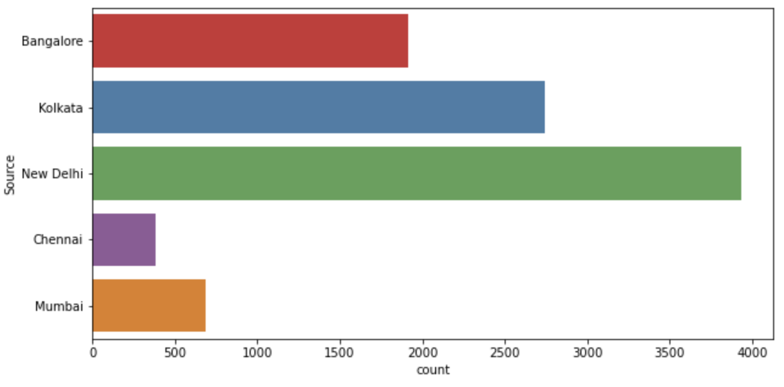
From above graphs it can be observed that on an average, the flight prices are the highest for January, with the prices being lowest for April
Flight Ticket prices are the highest on Thursdays followed by Mondays and Sundays
Highest number of flights are from New Delhi followed by Kolkata, Bangalore, Mumbai and Chennai

Slide 14
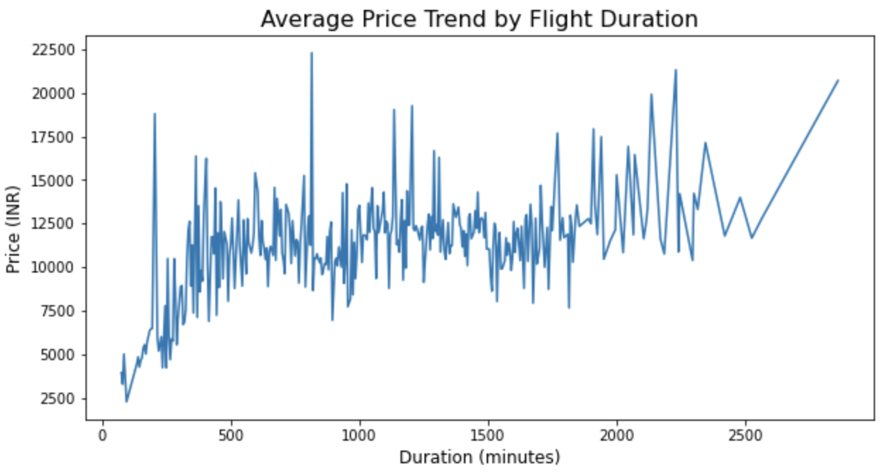
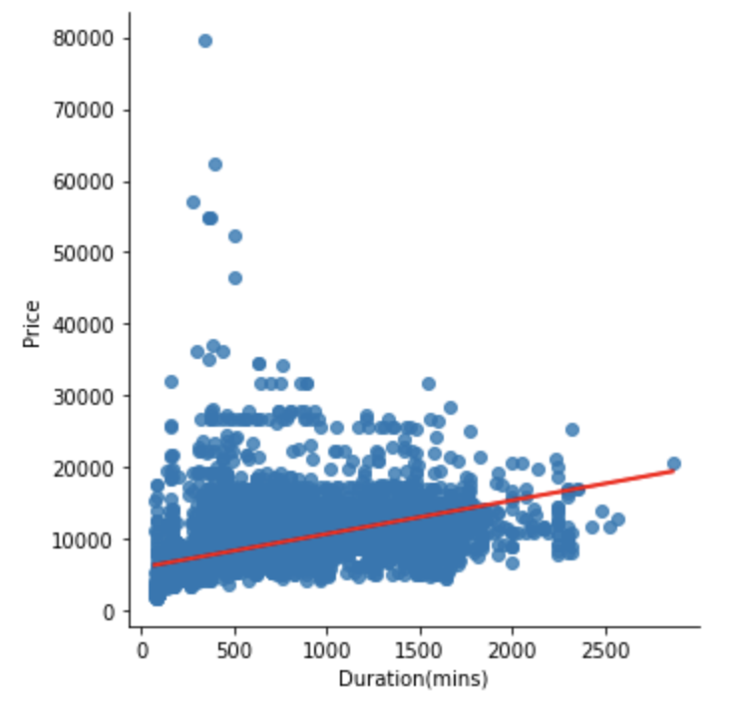
There is a linear relationship between Price and flight duration but not a very strong one. There are many exceptions or variations due to other factors like the airline, the route, the time of booking, and so on.

Slide 15
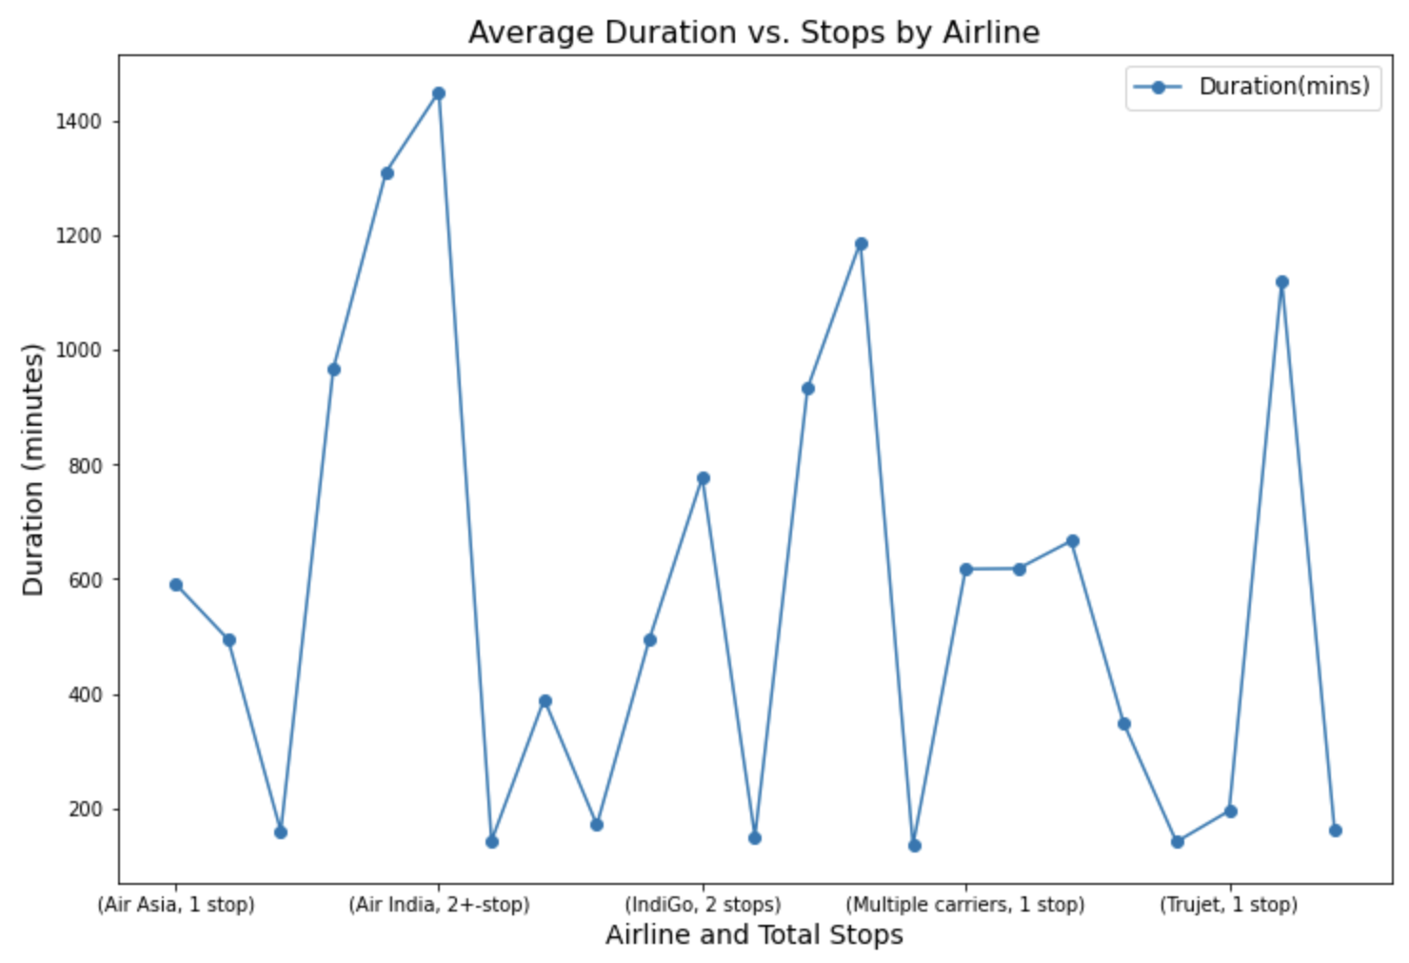
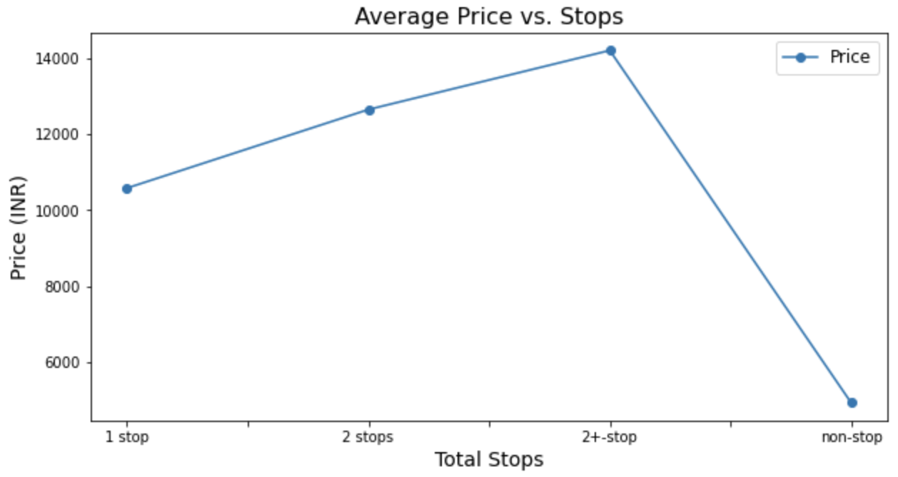
Number of Stops impact the travel time of Airlines
Also, number of Stops impact the Air Ticket Pricing of Airlines
Greater the number of stops, higher the price.

Slide 16
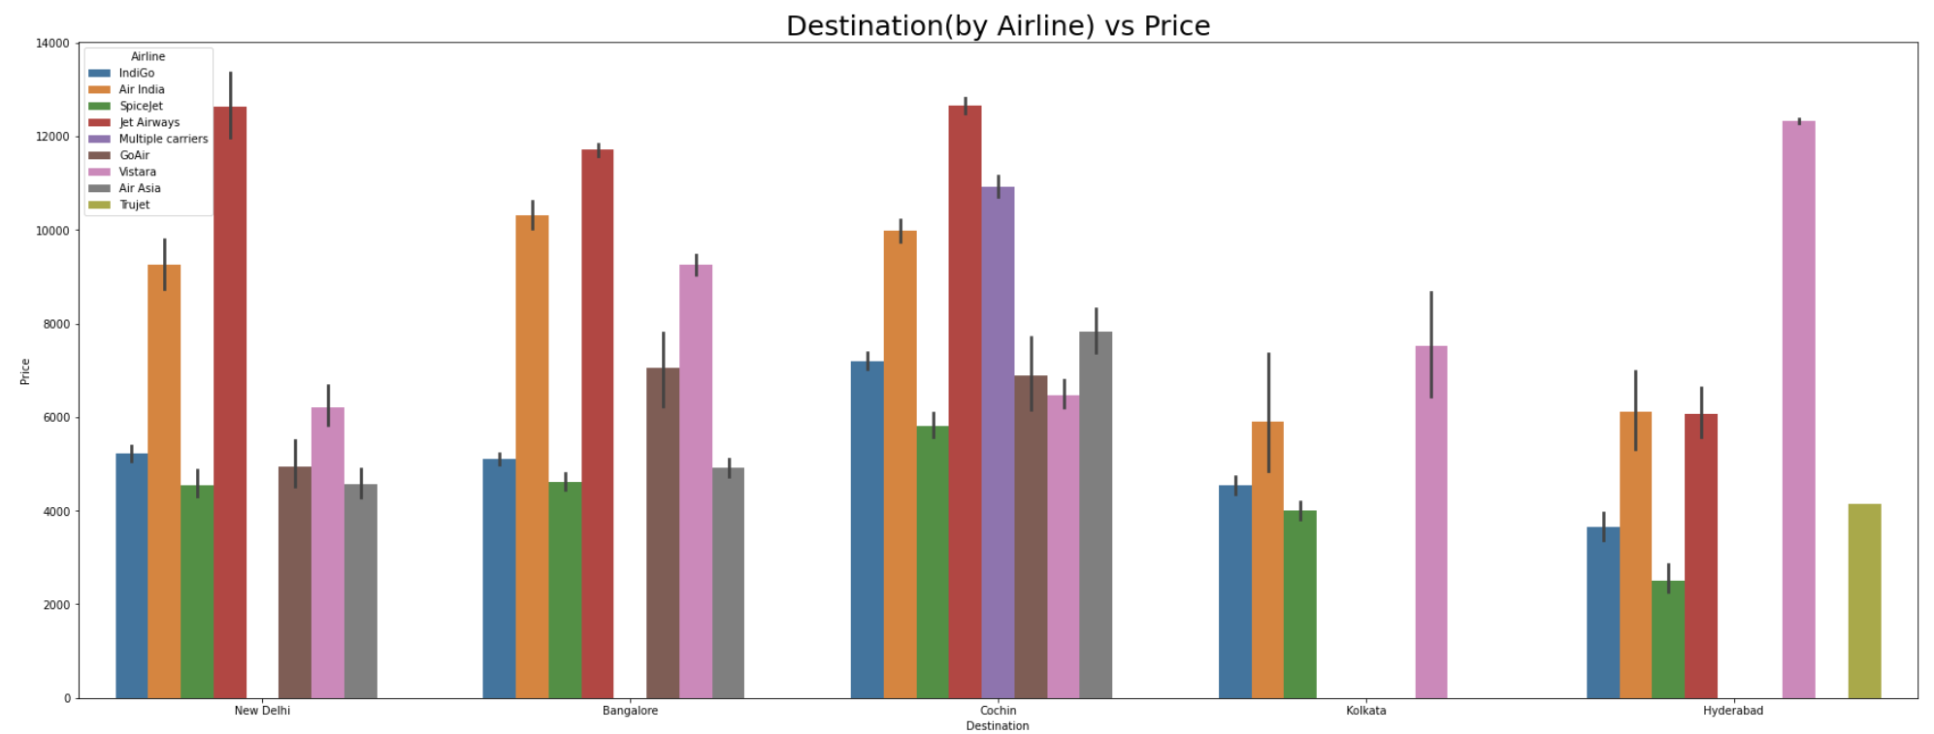
Cochin and Bangalore are the most expensive destinations and Kolkata and Hyderabad are the most affordable
Air Asia and Indigo provide most affordable Airtickets to the destinations

Slide 17
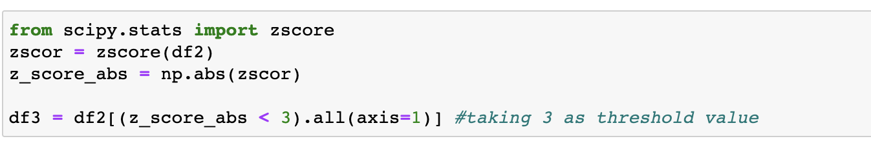
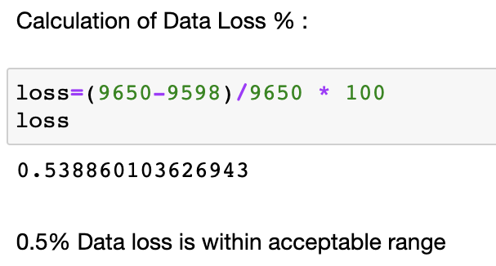
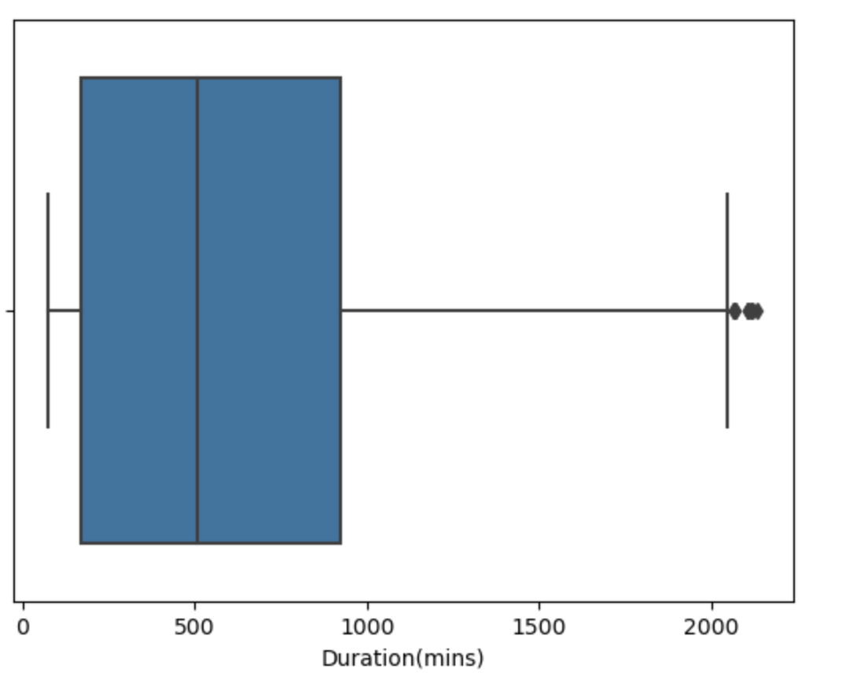
Removing Outliers Using Z-score Method
A lot of outliers have been removed

Slide 18
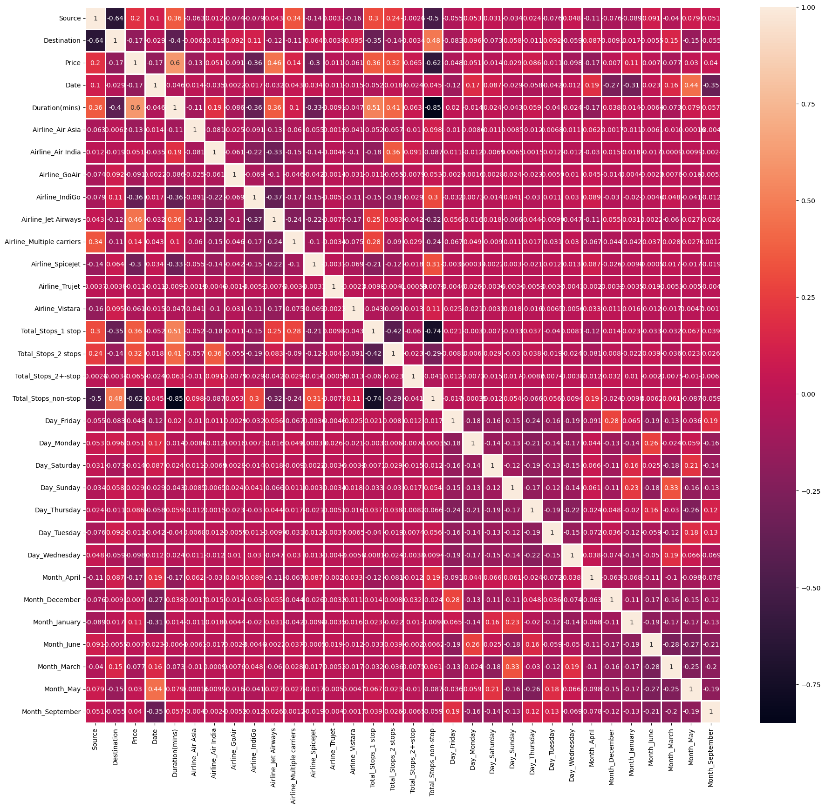
Finding Correlation

Slide 19
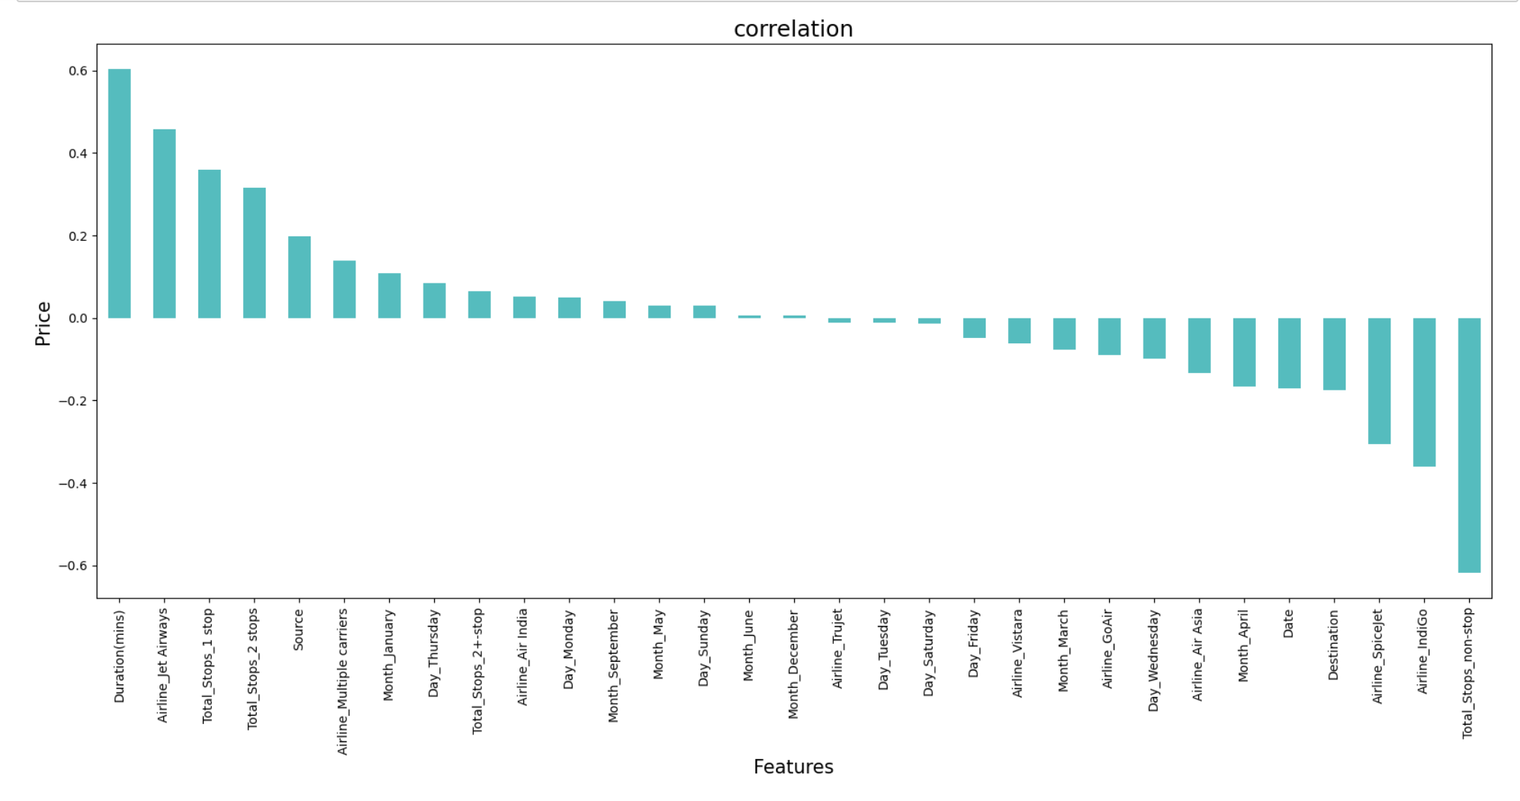
It is observed that Duration(mins), Airline_Jet Airways, Total_Stops_1 stop and Total_Stops_2 stops have the highest positive correlation with Price, while Airline_Spicejet, Airline_IndiGo, Total_Stops_non-stop have the highest negative correlation with Price.

Slide 20
Model Deployment
Random Forest Regression Model
Ridge Regression Model
XGB Regression Model
Support Vector Regression Model
Decision Tree Regression Model

Slide 21
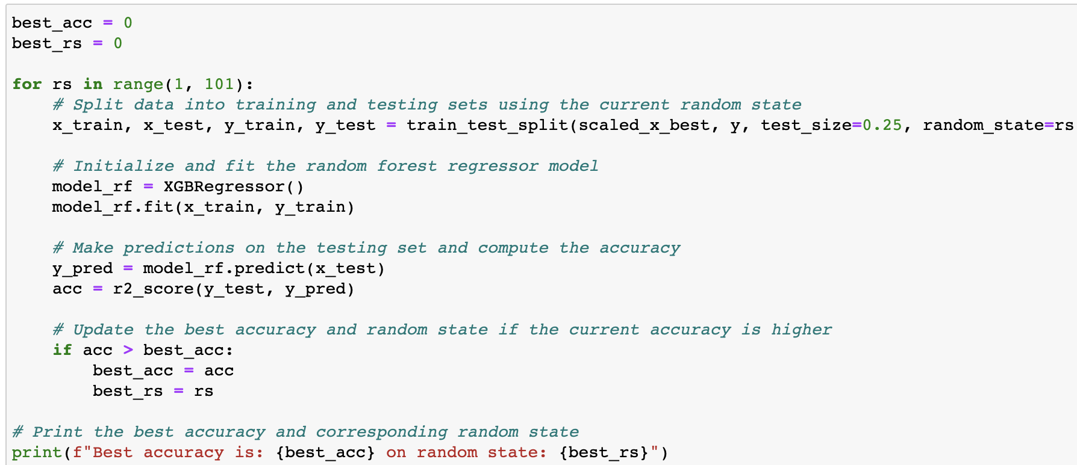
This is a Regression Problem since Target/ Label column ('Price') has Continuous type of Data :
Best accuracy is: 0.81903 on random state: 49

Slide 22
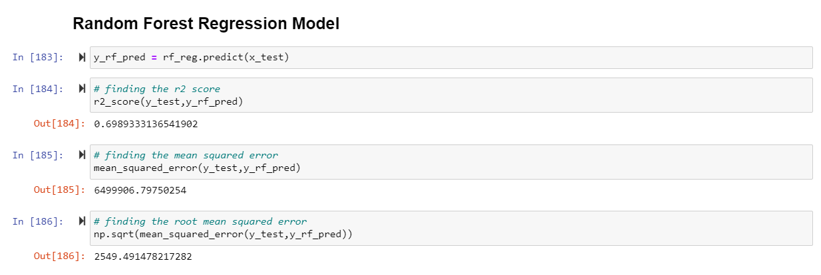
Random Forest Regression Model
The code calculated the predicted values of a trained random forest regression model for the test set, and evaluates the performance of the model using R-squared, MSE, and RMSE metrics.

Slide 23
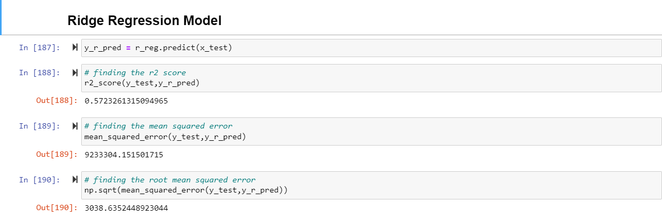
Ridge Regression Model :
The code predicted target variable values using a trained linear regression model and evaluates its performance using R-squared, MSE, and RMSE metrics on the test set

Slide 24
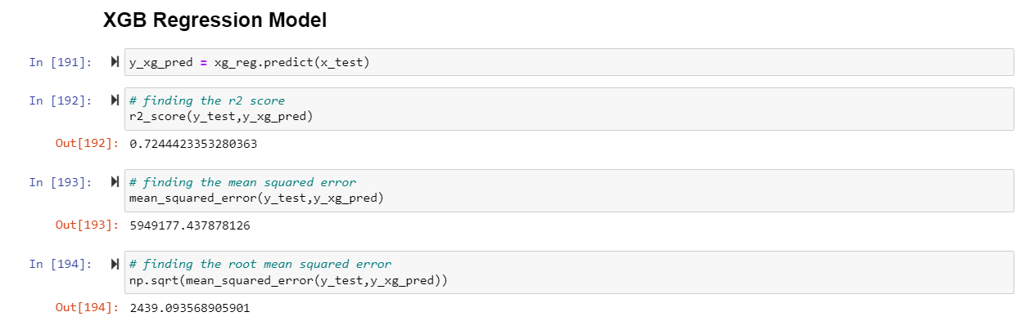
XGB Regression Model :
The code predicts target variable values using a trained XGBoost regression model and evaluates its performance using R-squared, MSE, and RMSE metrics on the test set

Slide 25
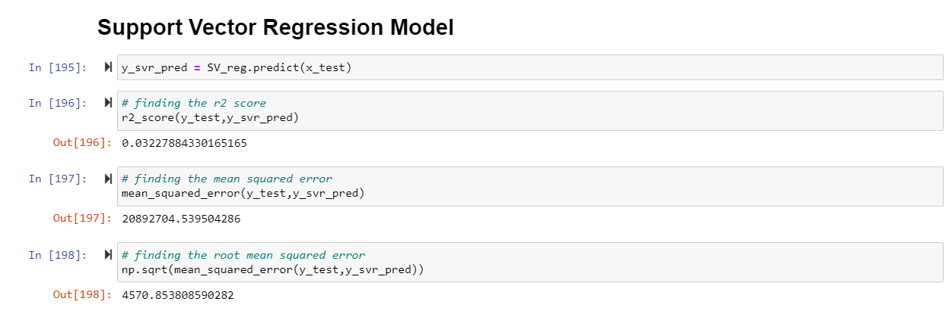
Support Vector Regression Model
The code predicts target variable values using a trained Support Vector Regression (SVR) model and evaluates its performance using R-squared, MSE, and RMSE metrics on the test set

Slide 26
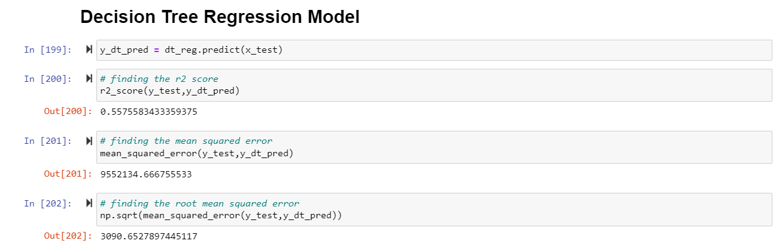
Decision Tree Regression Model :
The code predicts target variable values using a trained Decision Tree Regression model and evaluates its performance using R-squared, MSE, and RMSE metrics on the test set

Slide 27
Model Accuracy Result
ALGORITHM | R-SQUARED | MSE | RMSE
Random Forest Regression | 0.698 | 6499906.79 | 2549.49
Ridge Regression | 0.572 | 9233304.15 | 3038.63
XGB Regression | 0.724 | 5949177.43 | 2439.09
Support Vector Regression | 0.032 | 20892704.53 | 4570.85
Decision Tree Regression | 0.557 | 9552134.66 | 3090.65

Slide 28
Model Cross Validation :
MODEL | SCORE
Ridge Regression | 0.593
XGB Regression | 0.803
SV Regression | 0.047
Decision Tree Regression | 0.599
Random Forest Regression | 0.748
Based on comparing Cross Validation results, it is determined that XGB Regression Model is the best model
It also has the lowest Root Mean Squared Error and R-Squared values

Slide 29
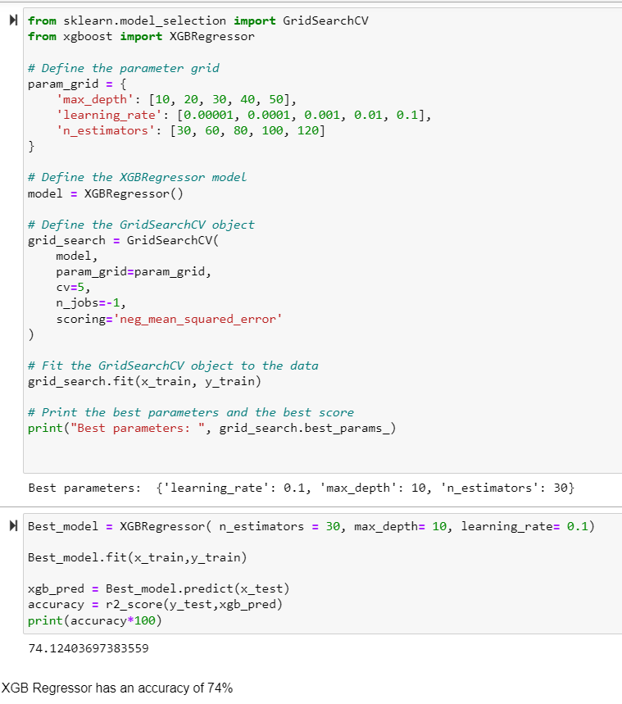
Hyper Parameter Tuning :
Hyper Parameter Tuning process involved selecting the most appropriate values for parameters. The process helped to fine-tune the model and improve its accuracy.
After Hyper Parameter Tuning, we get 74% accuracy

Slide 30
Conclusion
The application of machine learning (ML) models in predicting prices using historical data has demonstrated a significant improvement in the accuracy of price forecasts.
The project showcased the dynamic nature of flight ticket prices, revealing insights into the impact of factors such as weekends and time of day on price fluctuations.
This study serves as a compelling demonstration of the potential of ML models to enhance decision-making processes and optimize pricing strategies across a range of industries.

Slide 31
Further improvements :
Data Granularity: Incorporate more granular data points such as holidays, school vacation periods, or special events that could affect demand and pricing.
Competitive Analysis: Include competitor pricing data to understand the market position and potential for price adjustments.
Customer Segmentation: Analyze customer segments to tailor pricing strategies according to different groups' willingness to pay.

Slide 32
External Factors: Assess the impact of external factors like economic indicators or weather patterns on pricing.
Dynamic Pricing Models: Explore the development of dynamic pricing models that can respond in real-time to changes in demand and supply.

